Slide 1
Mumbai Restaurants Analysis

Slide 2
Why Mumbai Restaurants only ?
Mumbai is a densely populated capital city of state Maharashtra on India’s west coast. It is the country’s financial and commercial centre and its principal port on the Arabian Sea. Mumbai is India’s most-populous city, and it is one of the largest and most densely populated urban areas in the world with an estimated city proper population of 12.5 million living under Municipal Corporation of Greater Mumbai.
The metropolis has a roadside fast food consisting of Maharashtrian Pav Bhaji, Vada pavs, Dabeli, Panipuri, Bhelpuri, etc. South Indian and Chinese food is also popular in the city. Lebanese, Korean, Thai, Italian, Mexican, Mughlai, Punjabi, Mālvani, and Continental cuisine are also popular in Mumbai.

Slide 3
Why Mumbai Restaurants only ?
Mumbai has the largest of the organised food service markets pegged at nearly Rs 41,000 crore. Mumbai has the highest share in the organised market -which mainly accounts for standalone restaurants. Interestingly, in Mumbai, among international cuisines, 33% prefer Italian compared to 29% who like Chinese. People in the island city also prefers south Indian food to north Indian cuisines.
As Mumbai and its sub-urban area is growing, the number of restaurants is increasing day by day. Currently which stands at approximately 13,790 restaurants. With such a high number of restaurants, this industry is yet to saturate. In addition, new restaurants are opening every day. However, it has become difficult for them to compete with already established restaurants. The key issues that continue to pose a challenge to them include high real estate costs, rising food costs, shortage of quality work force, fragmented supply chain and over-licensing.

Slide 4
Data acquisition and cleaning
The main data used for this project were from two sources:
The restaurants data from the Zomato website was obtained from Kaggle website.
Explore trending venues in a neighbourhood particularly restaurant (Foursquare API).
In total, more than 6000 rows and 16 features in the raw dataset.
Duplicate, highly similar or highly correlated features were dropped.

Slide 5
Popular Food/Most Liked food in a restaurant
For each of the restaurant review all those review(greater than 3) that contained food items from the dataset in it were extracted. Ex. Chinese was good, North Indian was tasty etc.
A careful analysis of the dataset was done to remove extra menu that were not related to food item.
After extracting the liked food for each of the restaurant it was stored in a list of menu items which will be used for our analysis.
Also, geographical coordinates of each restaurant was extracted from the dataset to visualize it through maps.

Slide 6
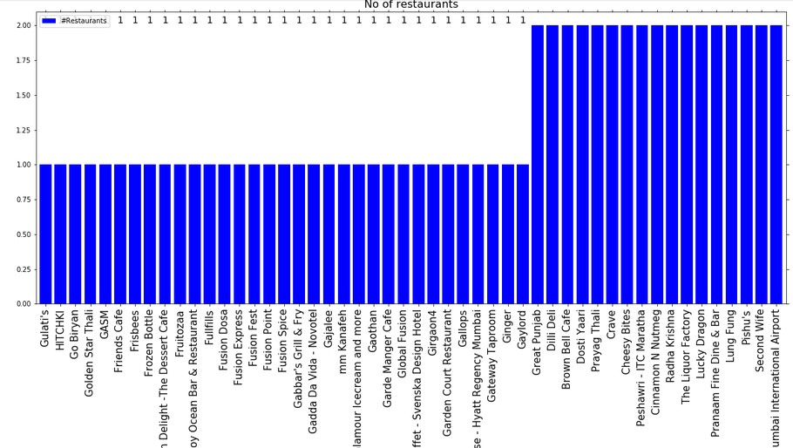
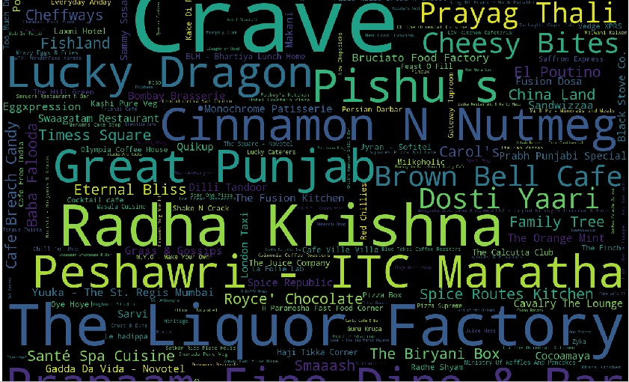
Number of restaurants in Mumbai

Slide 7
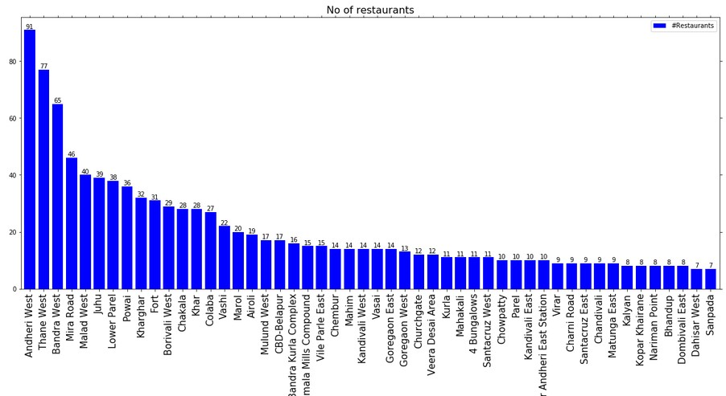
Number of restaurants in each neighbourhood

Slide 8
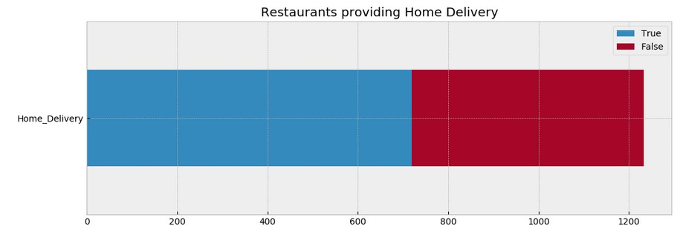
Number of restaurants providing Home Delivery

Slide 9
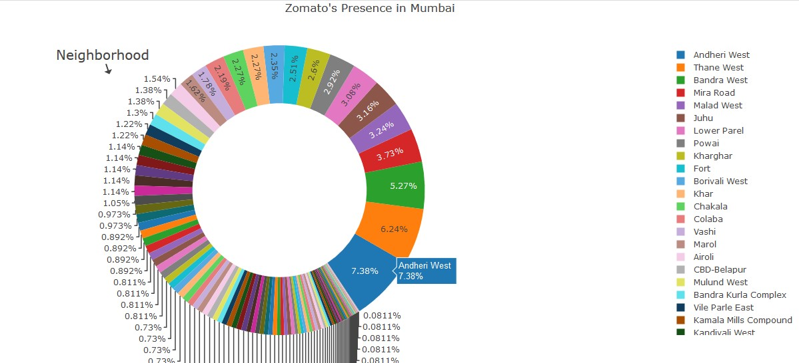
Zomato’ s presence in Mumbai

Slide 10
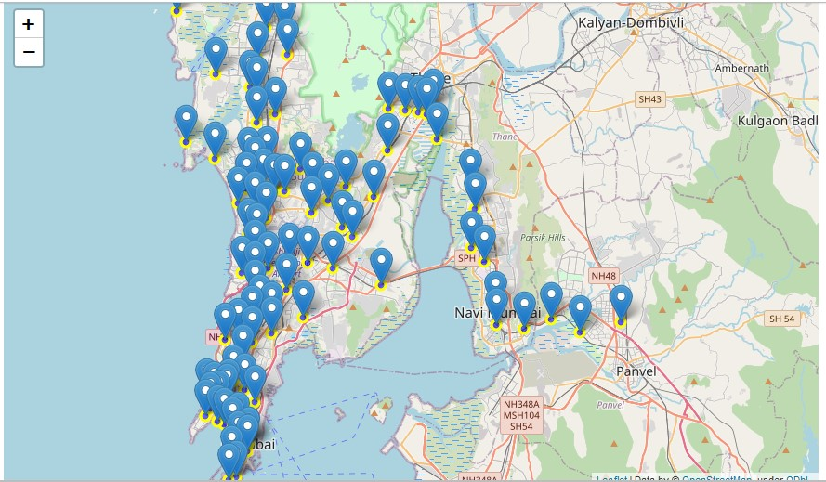
Restaurants geographical location in Mumbai

Slide 11
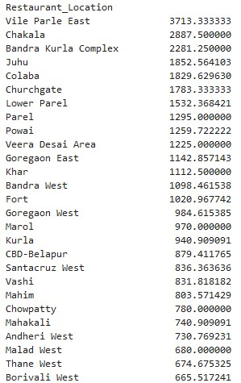
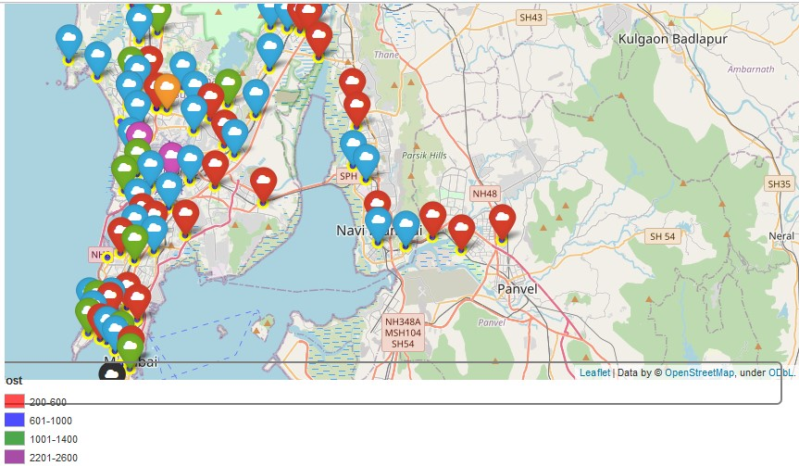
Approx. cost of food by neighbourhood
From results we can figure-out that cost of living in Vile Parle East quite high

Slide 12
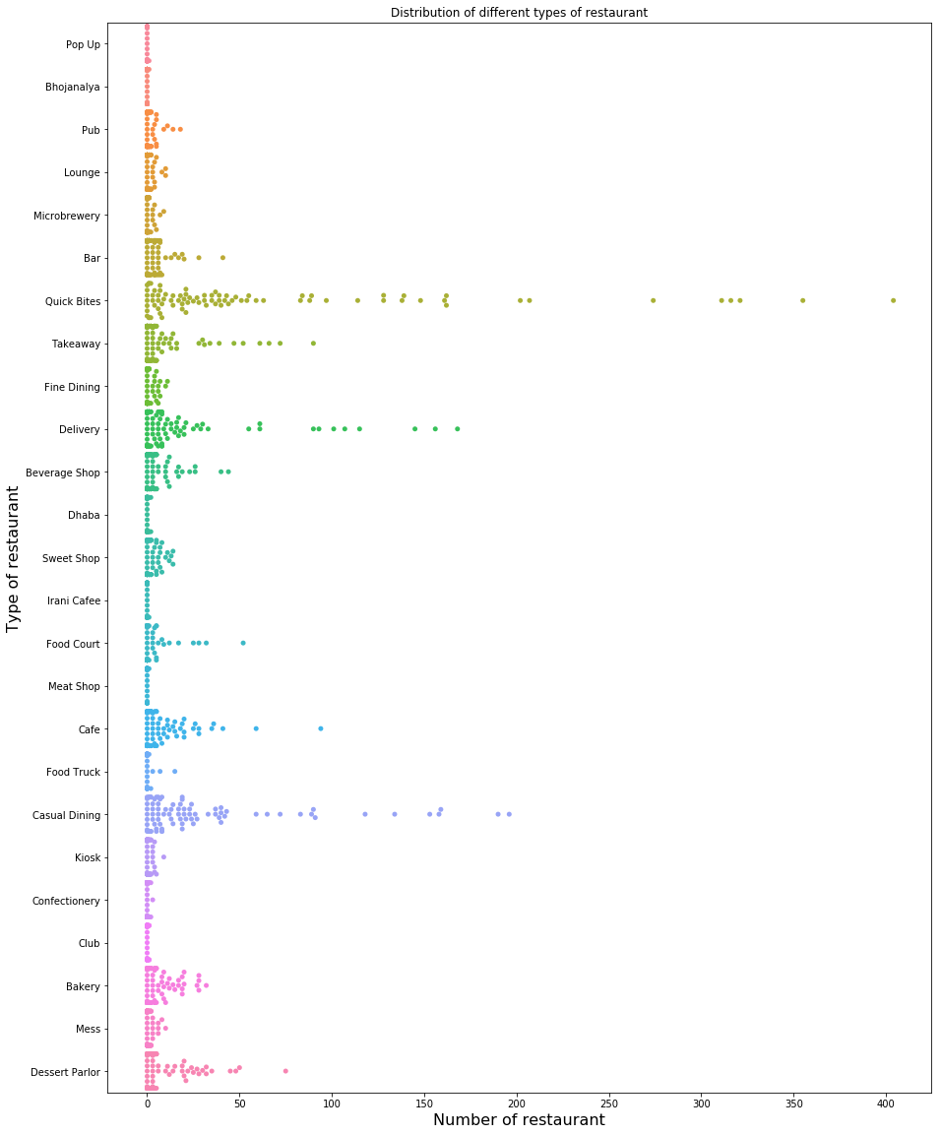
Grouping neighbourhood by Types of Restaurants

Slide 13
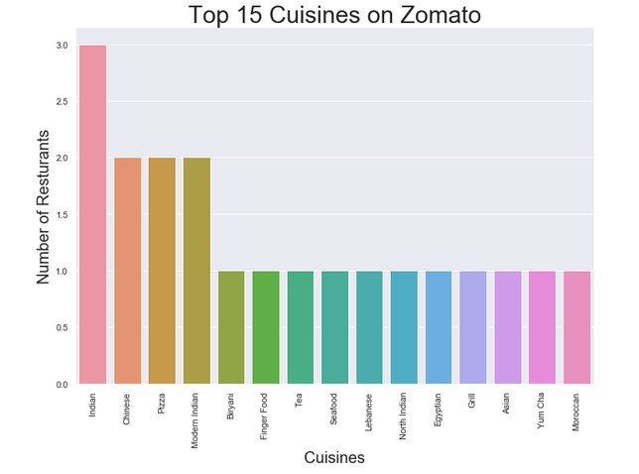
Regression models performance
We can observe that in Mumbai but Indian dishes are more famous followed by Chinese, pizza and Modern Indian.

Slide 14
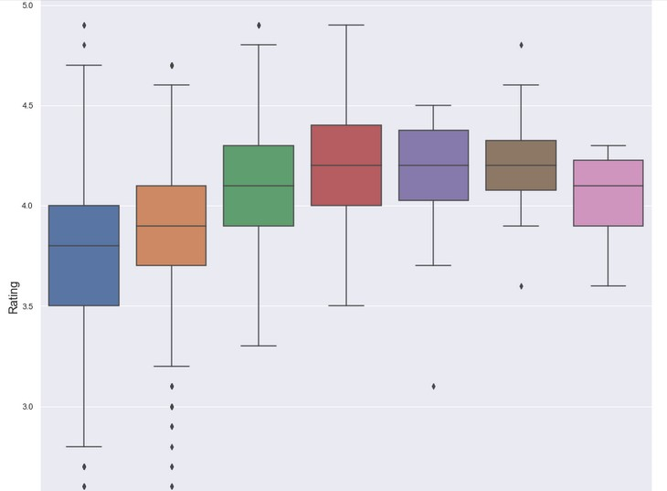
Price range vs Rating comparison

Slide 15
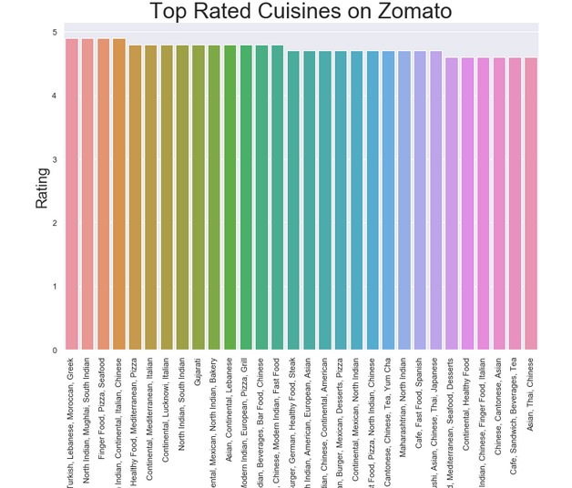
Top rated cuisines on Zomato Mumbai

Slide 16
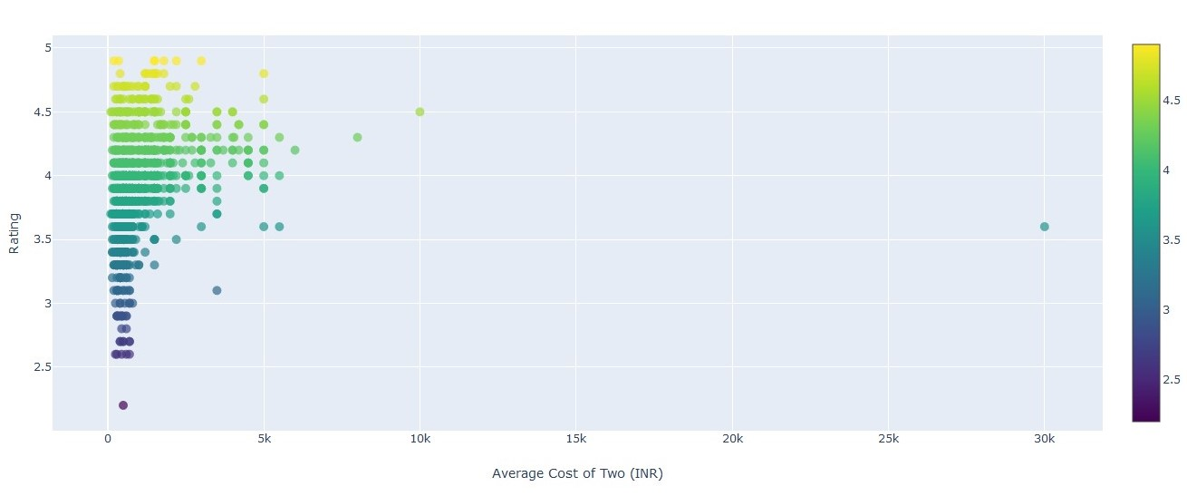
Rating and cost
Pearson correlation. Null Hypothesis : There is no relationship between the rating and price of the restaurant Alternate Hypothesis : There is some relationship between the two.
Pearson Correlation Coefficient: 0.2268062259131467 and a P-value of: 3.771334182453177e-15
Reject our NULL hypothesis. There is some relationship between the two

Slide 17
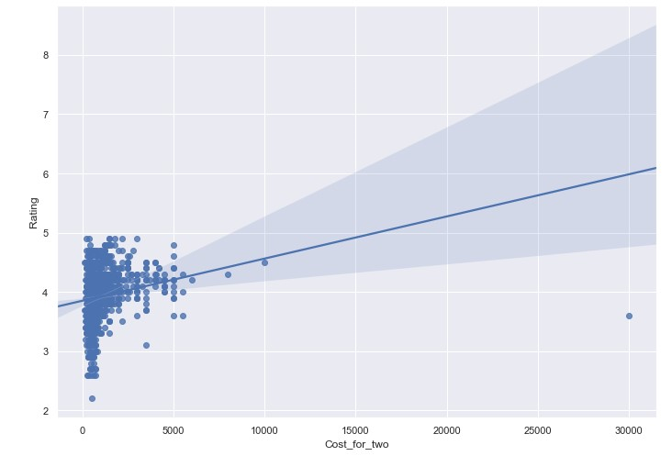
Does more votes means Higher Ratings?
As it seems, from a quick glance, there is no observable linear relationship. At almost every price point, there appears to be both low and high cost restaurants.
Pearson Correlation Coefficient: 0.4481341033447588 and a P-value of: 5.149782109217486e-59
We reject our NULL hypothesis and accept the Alternate Hypothesis i.e. both the variables are related and our finding was statistically significant

Slide 18
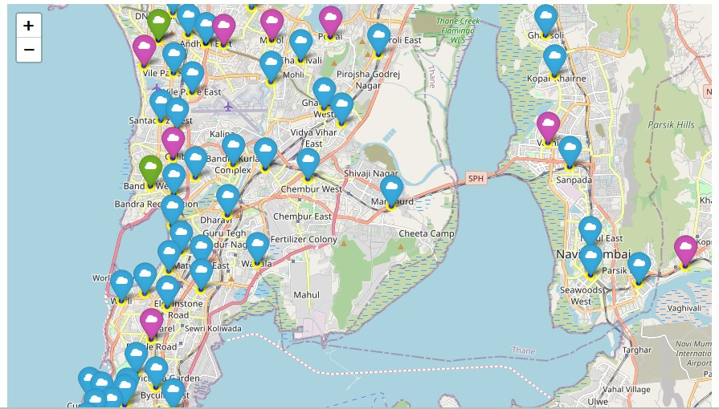
K-means clustering based on Cuisines
Cluster 1 are those marked in Blue are the places that are more famous for its North Indian food, Chinese and Fast food.
Cluster 2 or those marked in Green are those places that are more famous for its International, Indian, Chinese as well as fast food.
Cluster 3 or those marked in Purple were those areas where Street Food, Chinese, Fast food are least popular

Slide 19
Conclusion and future interpretation
Quick service restaurants/home-delivery based business model are now mainstream of the Indian food service market, and are growing fast. Fine dining is gaining prominence too. Both multi-cuisine and single-cuisine establishments have seen tremendous growth.
The model and the idea can be used in real life if we get the access to the ordering data of Zomato.
Certainly about entire neighbourhood which is really large is not possible. But the taste of a locality can be found out by their ordering pattern and the types of restaurant.
Crave has its outlet in most of the neighbourhood of Mumbai followed by other key players. The Indian food service market has seen tremendous changes and disruption when compared to early Nineties when it was dominated by unorganised players and few brands.
These pattern can be analysed from the data which is seen in the real life too. Thanks to the diversity of Indian food market. The data can also be used to find out the popular food, type of people, residency area etc. to help new restaurants take better data driven decisions.

